Slide 1
Machine Learning on Patent data
What it tells us about Innovation and Strategy
2015-03-05
Nigel Swycher and Steve Harris
AISTEMOS Limited
aistemos.com

Slide 2
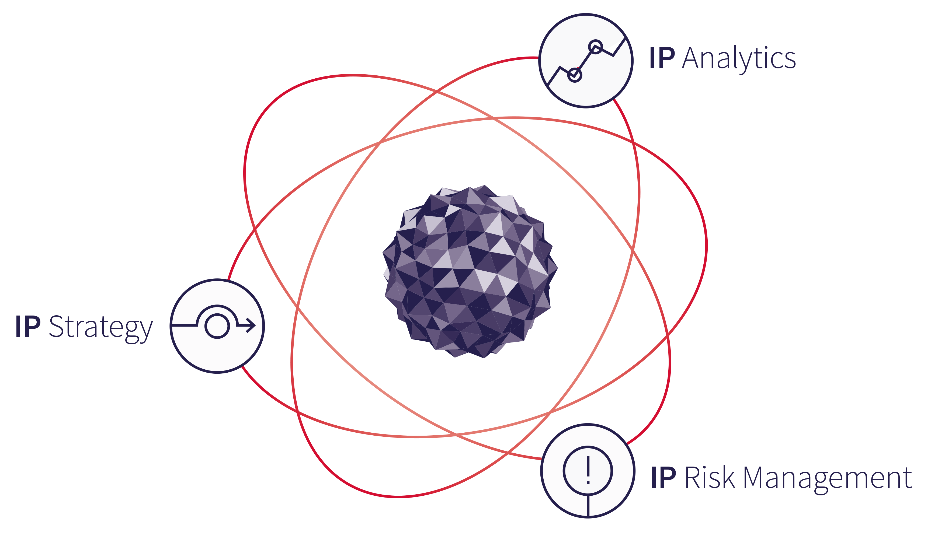
Aistemos
Strategy
  Aistemos was founded by Nigel Swycher, who has over 25 years of experience advising on the creation and exploitation of IP
Analytics
  Cipher is our first analytics product focussing on the visualisation of patent data from a corporate perspective
Risk Management
  Aistemos advises on a range of innovative products aimed at managing IP risk

Slide 3
About patent data
Mostly unstructured text
What metadata exists, is of poor quality
Incomplete
Often obfuscated
Changes daily
…but valuable enough that it is worth applying significant resources to find underlying patterns
A common situation in many data-intensive industries
2

Slide 4
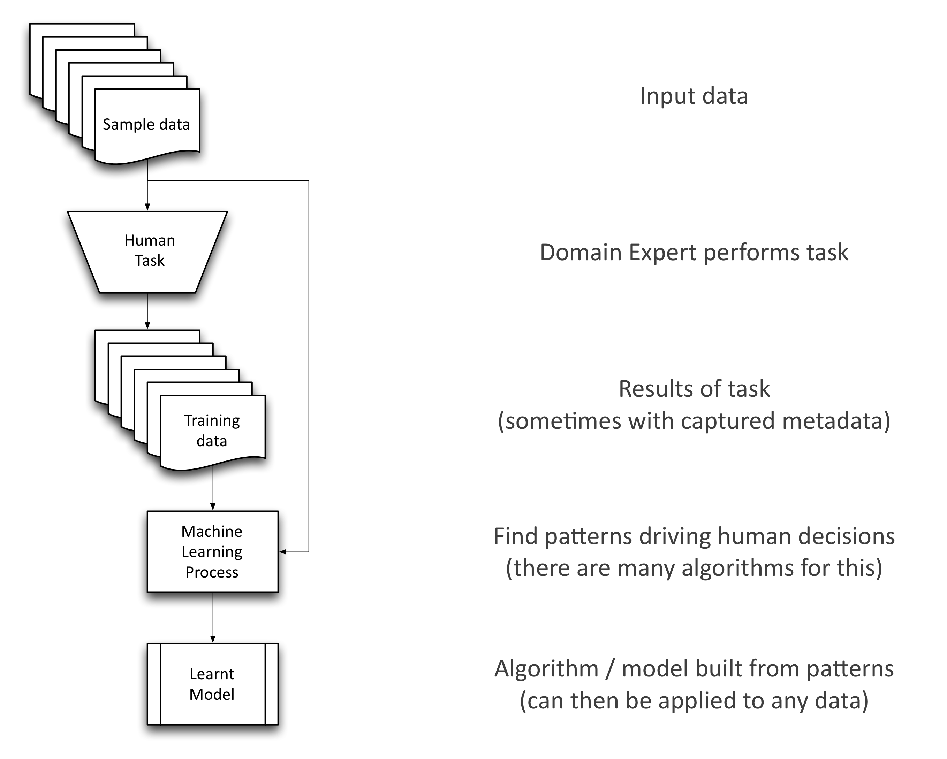
(Supervised) Learning Workflow
3

Slide 5
Example: Clustering
Get domain experts to cluster portfolios from different industries
Learn from that how to calculate the “similarity” of different patent families
Use an Unsupervised Learning algorithm to break down portfolios into areas of technology
  Not pre-determined
  Emerging naturally from the portfolio
4

Slide 6
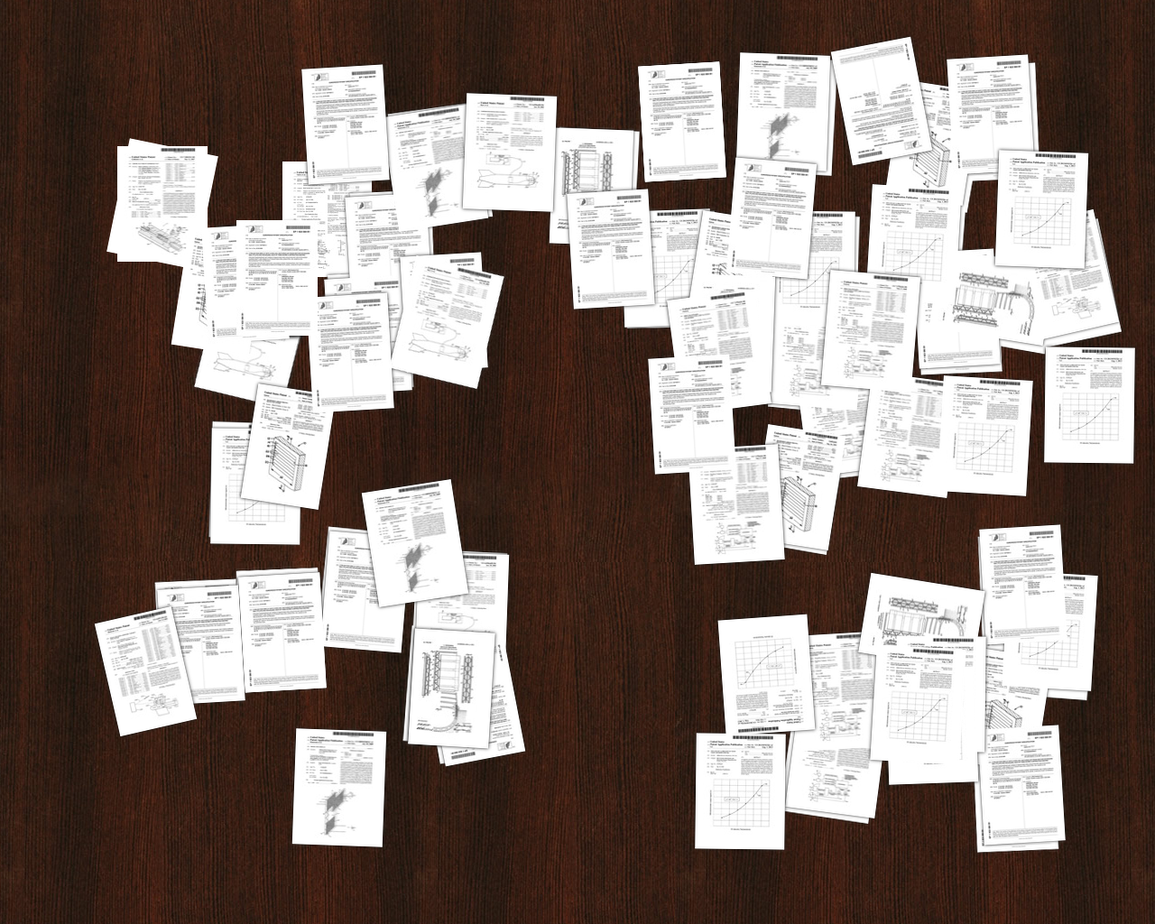
From unstructured documents
5
Notes:
BAE have ~3700 active patents

Slide 7
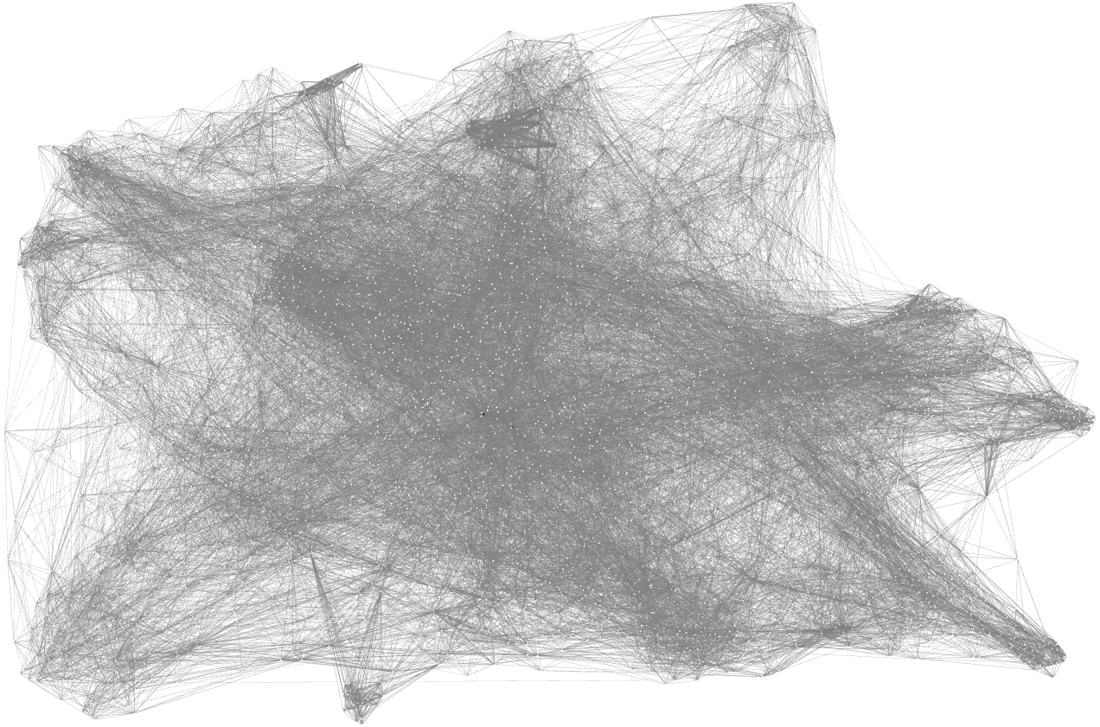
To similarity measures
6

Slide 8
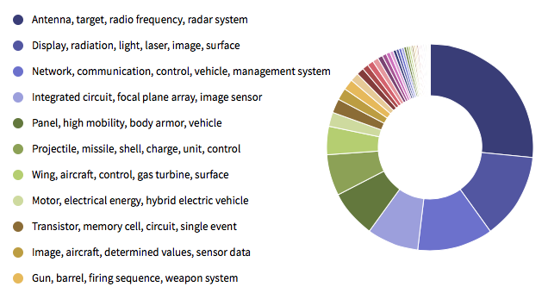
To clusters
7

Slide 9
Example: Finding comparable portfolios
Another similarity based algorithm
But, different criteria, different approach
  Patents within portfolios tend to use same terminology, have common authors etc.
  Across portfolios we need to be language neutral
Unsupervised Learning algorithms can identify common themes in unstructured documents
  E.g. Topic Modeling / LDA, classical IE Name Resolution
Combine output of Unsupervised tagging with graph distance metrics to produce a similarity score
8

Slide 10
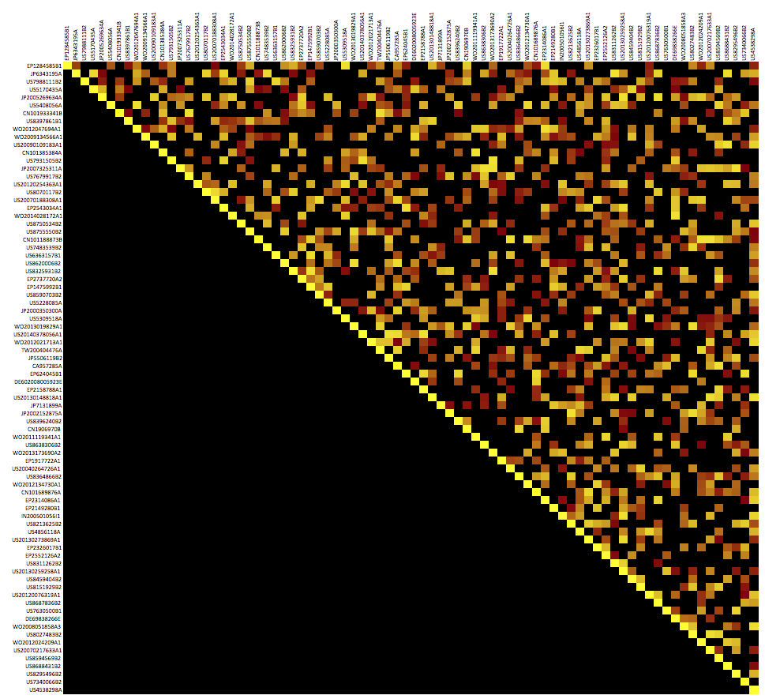
Brute force calculations
x 300,000
9
Notes:
23M x 23M, symmetric, 1% density = 1.2TB => ~4 nodes

Slide 11
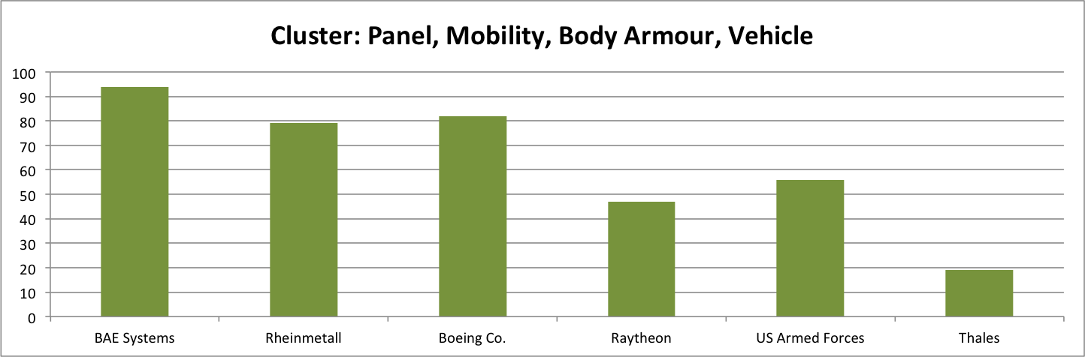
Identify comparable patent sets
Given a pre-calculated similarity matrix, we can:
  Identify all the sufficiently similar patents
  Group them by 2nd party owner
  Correct for the non-relevant patents owned by the 2nd party
  Produce a weighted similarity measure for the top N most similar companies
In real-time (sub 1 second)
Can be done for any arbitrary collection of patents
2nd party patents can be mapped to clusters
10

Slide 12
Application to other domains
With modifications both of these techniques can be applied more generally:
  Clustering documents
  Identifying authors by example
We’ve described the application in the patent domain as it’s the one we developed the techniques for
The combination of machine learning systems and brute force compute clouds is very powerful
11

Slide 13
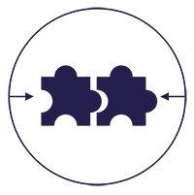

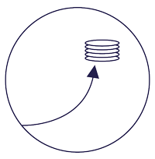

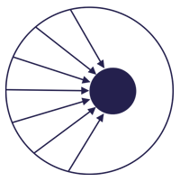
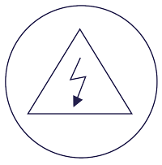
Cipher use cases
IP Strategy
IP business intelligence as a common language
Competitive Intelligence
Aggregation and analysis of organisations and their comparables
Collaborations
Support for inbound, outbound and cross-licensing
CUSTOM ANALYTICS
ACQUISITIONS/DIVESTMENTS
LICENSING
Due Diligence
A fast, early and accessible view of risk and value
Investment Screening
Identification, analysis and assessment of targets
Risk Management
Quick view of litigation landscape, for both OpCo and NPE activity
DEALS
SCOUTING
LITIGATION
12

Slide 14
The clear shift in SAP’s innovation strategy
Database & Memory
Other
13

Slide 15
Siemens dominance in process automation, soon to be overtaken by ABB
14

Slide 16
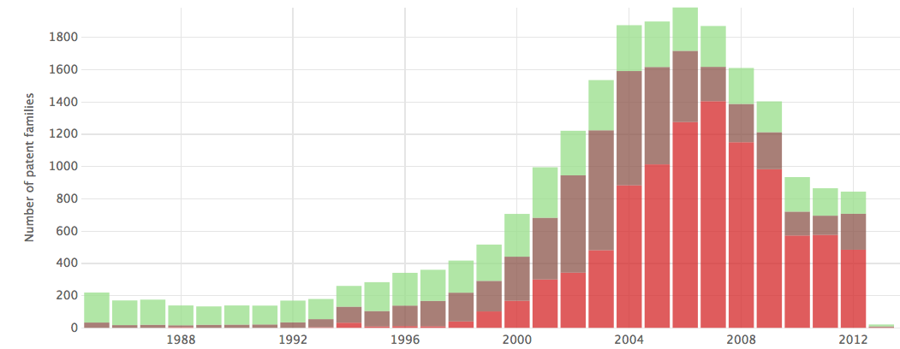
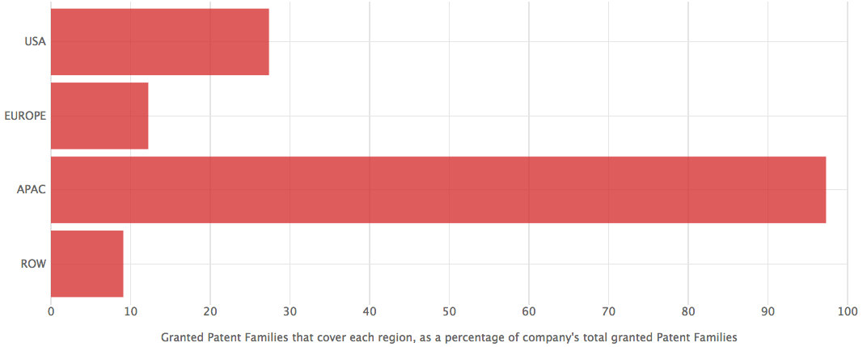
Toyota, late to the fuel cell game.
Opening up portfolio, but only has JP coverage
15

Slide 17
Thank you
aistemos.com

